Slide 1



MATUL
THESIS/
PROJECT
Research Thesis/Project
For 18 months you have enjoyed exploring nooks and crannies of conversations among the poor.
Now we bring you…
PHILOSOPHY & SKILLS FOR CREATING RESEARCH THAT INTEGRATES THOSE Conversations INTO ACADEMIC KNOWLEDGE FORMATS
Notes:
To view this presentation, first, turn up your volume and second, launch the self-running slide show.

Slide 2
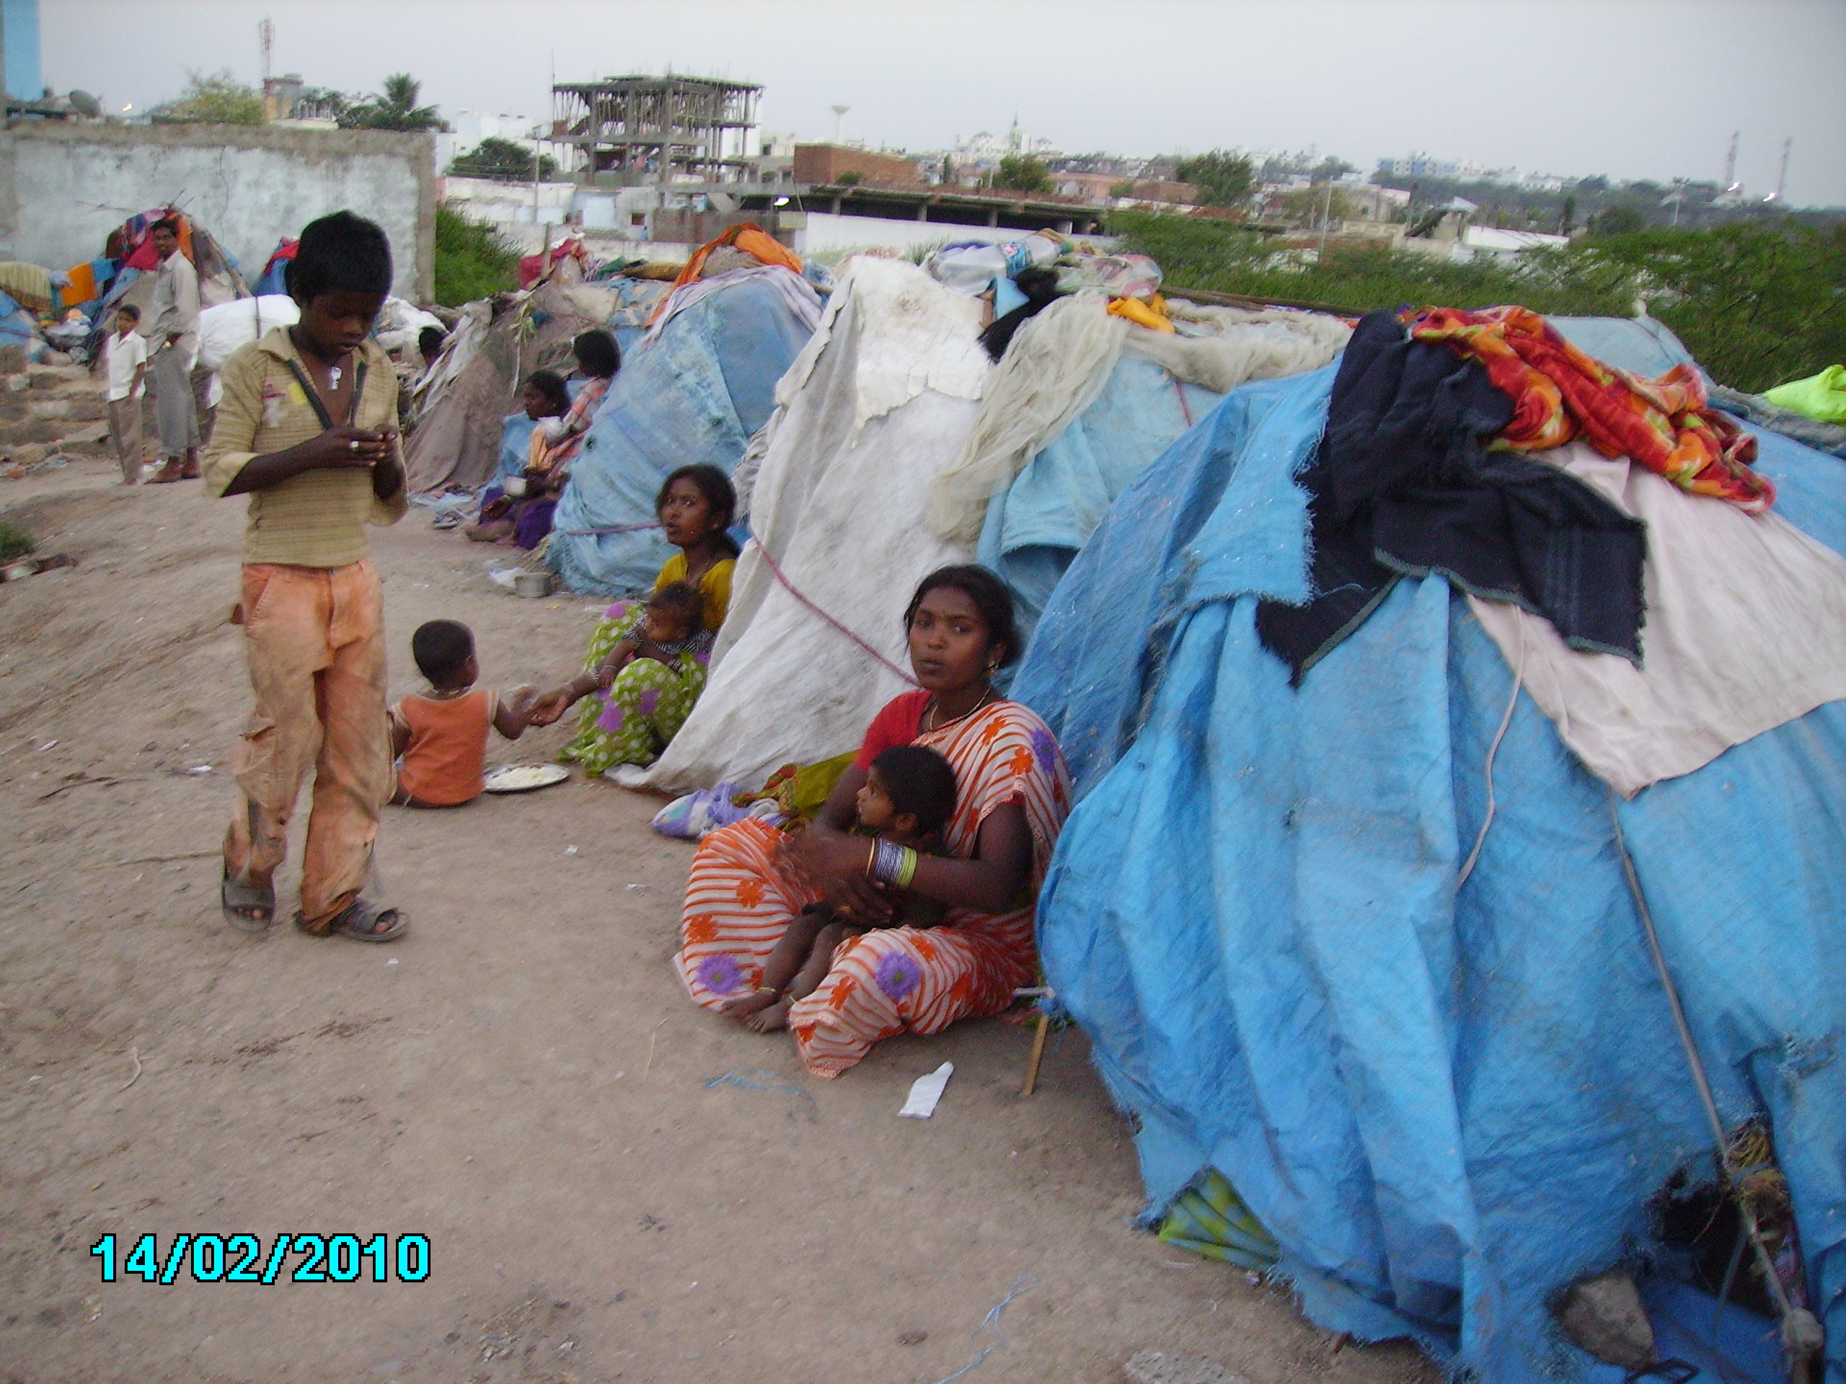
I. Transformational Conversations
A Theological Framework for the MATUL degree
Finding God (3-6) in a context of oppression (7) through solidarity (8), spiritual power (15,20), advocacy (10), entrepreneurial vision (17), community organization (16-22) - Exodus 3

Slide 3
Urban Theological Foundations
Is God or was God?
Is God or does God?
Is God incarnate or cosmic?
Is God a holistic Story teller or a rationalist philosopher?

Slide 5
All Theologies are Contextual Theologies
Irish Catholic
Italian Catholic = Systematic
German Reformation = Systematic
Latin American Liberation = Justice –Based Theologies
American Evangelical = modernist logical
Slum Pentecostal = Oral Theologies

Slide 6
Urban Missions Research
Transformational Conversations
Theological Reflection
Entrance Action
Social Analysis
Social Science Models
Transformational Conversation
Integration
New Action Steps
Community Development Theories
Biblical Study
Theological Analysis
Presentation of Research

Slide 7
II. Action Research
Research for Change
God is a God of Action in History
Kingdom –directed Research

Slide 8














Involve Action
Based on Vision
Based on Insight
Notes:
…global causes.

Slide 9








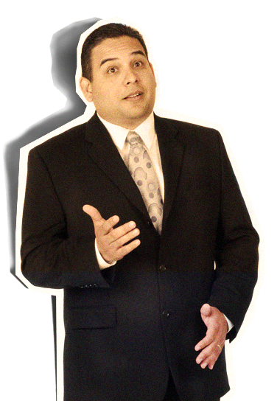

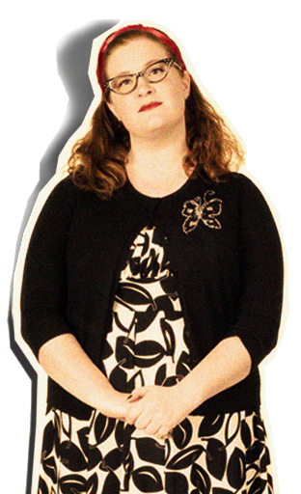

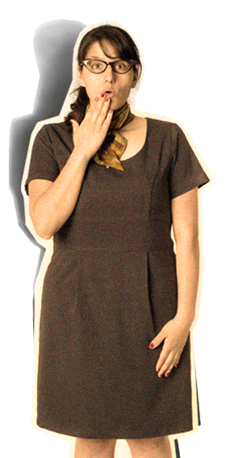
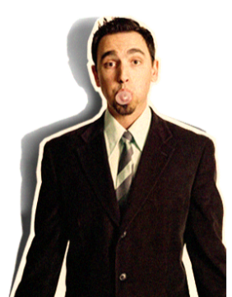
Aim at Changing
Decision-makers Minds
Notes:
…and you will undoubtedly find favor with the king.

Slide 10
Calendar your deadlines
Discuss where you want to end up and how this piece of published work will help
Review the Syllabus
III. PROCESS
a. change lives.
b. give entrance to your future work

Slide 11
Philosophy
Assessment of Context
Consult Organizational Leaders
Chart the Journey
Literature review & ethics
Entrance Story
Planning a Proposal

Slide 12
Participant Observation
Social & Theological Analysis
Data Collection
Data Analysis
Theoretical Development
Recommendations
Doing Research

Slide 13


Communicating Results of Participatory Action Research
4
SPREAD
IDEAS
AND
MOVE
PEOPLE
Notes:
The second rule is: Spread ideas and move people.

Slide 14







Aim at Changing Community’s Mind
= Social repentance
Notes:
Presentations are a powerful communication medium.

Slide 15
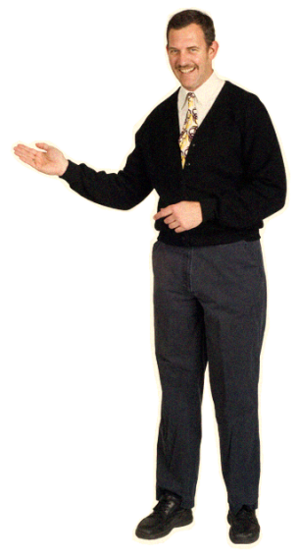
$
Research begins with knowing your decision-makers
It ends with carefully crafted communication – that results in their generating effective community action
Notes:
Give them those things in a clear, easily understandable way…

Slide 16
BLAH
BLAH
BLAH
BLAH
BLAH
How Not to Write Research
BLAH
BLAH
Notes:
Your audience didn’t show up to read your 60 page on screen dissertation.

Slide 17
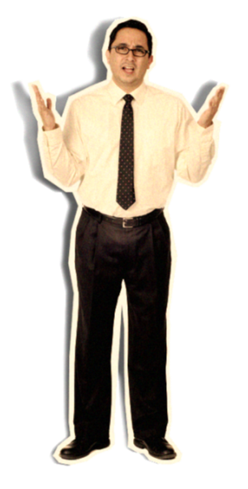
Underlying Communications assumptions
Truth exists
Can be defined
Can be communicated
Notes:
But the question remains—Why go to all this trouble?

Slide 18
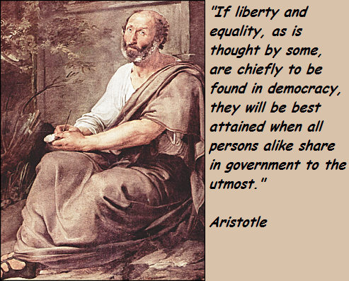
Communication Style of Theological Action Research
Conversation Conclusions
Communication Style 1: Academic: Aristotle and Plato determine the logic of communication of academic research
Communication Style 2: Becoming interpreters of the grassroots to those in decision-making roles through accurate ferreting out of the issues and needed directions of change.

Slide 19

RULES
THERE ARE RULES IN ACADEMIA
BREAK THEM AND YOU ARE MINCEMEAT
Learn rules of research design
Learn rules of data collection and analysis
Learn rules of academic communication
Notes:
So there are the rules.

Slide 20
Community Meeting Setup
4 page Graphical Flyer
Arrange Meeting with CO Leaders
Community Meetings
Community Org Meeting
Action
Communicating Research

